Slide 1
DSCI549: Introduction to Computational Thinking and Data Science
10g – publishing Data

Slide 2
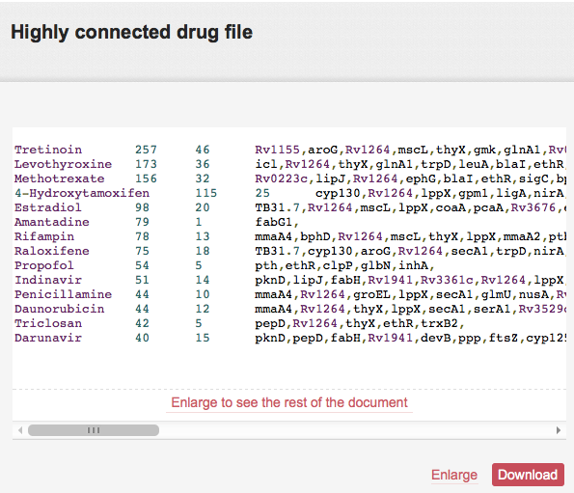

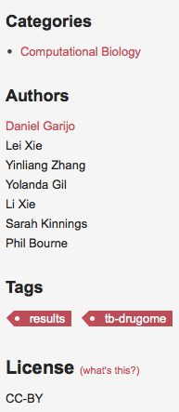




Making Data Accessible: Overview of Best Practices
Publication in a
shared repository
1
2
General & domain metadata
3
Accessibility of
Data (manual & machine)
Unique persistent
identifier (PID)
4
5
Citation preference
Notes:
A persistent identifier (PI or PID) is a long-lasting reference to a document, file, web page, or other object.
The term "persistent identifier" is usually used in the context of digital objects that are accessible over the Internet. Typically, such an identifier is not only persistent but actionable:^{[1]} you can plug it into a web browser and be taken to the identified source.

Slide 3
Making Data Accessible: Overview of Best Practices
Publication in a
shared repository
1
2
General & domain metadata
3
Accessibility of
Data (manual & machine)
Unique persistent
identifier (PID)
4
5
Citation preference

Slide 4






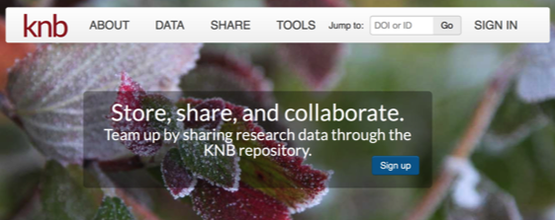
Popular Data Repositories
Not Curated
Curated
"Pangaea logo hg" by Hannes Grobe/AWI - Own work. Licensed under CC BY 3.0 via Wikimedia Commons - http://commons.wikimedia.org/wiki/File:Pangaea_logo_hg.png#mediaviewer/File:Pangaea_logo_hg.png
http://www.arqhys.com/articulos/ingeniero-inspector.html
Notes:
Curated resources may not accept direct submission of data.
2017 PANGAEA Curator Amelie Driemel

Slide 5

Directories of Research Data Repositories
http://www.re3data.org
http://databib.org/index_subjects.php
http://oad.simmons.edu/oadwiki/Data_repositories
http://www.force11.org
http://www.nature.com/sdata/data-policies/repositories
http://www.thestaffingstream.com/2012/08/06/the-buzz-about-talent-communities/

Slide 6
Making Data Accessible: Overview of Best Practices
Publication in a
shared repository
1
2
General & domain metadata
3
Accessibility of
data (manual & machine)
Unique persistent
identifier (PID)
4
5
Citation preference

Slide 7
Recommended Metadata
General
Domain Specific
Dataset name/title
Description
Creator(s)
Publication date
License
Publisher/contact
Version
Resource type
Location of the data
Categories
Keywords/tags
Related links
A data repository in a given discipline may request metadata using accepted standards

Slide 8

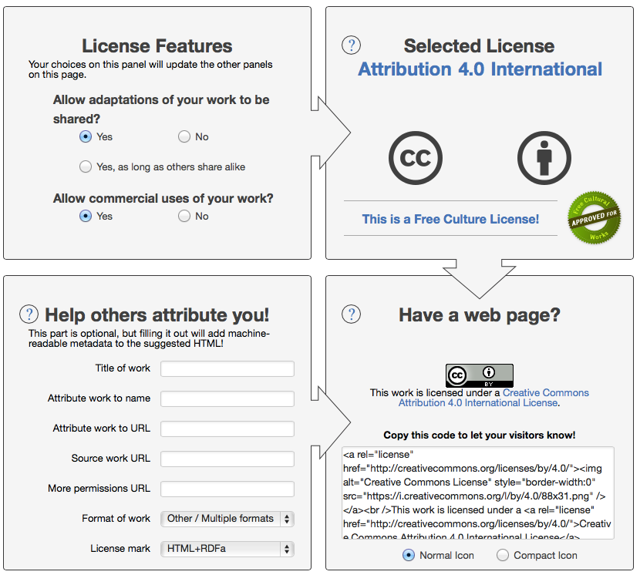
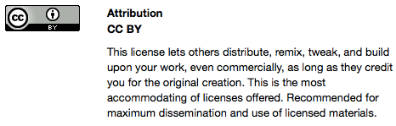
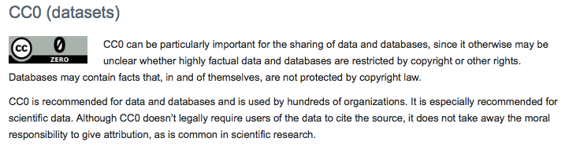
Choose a License: Creative Commons
Recommended: CC-BY and CC0
“No rights reserved”
http://creativecommons.org/licenses/

Slide 9
Making Data Accessible: Overview of Best Practices
Publication in a
shared repository
1
2
General & domain metadata
3
Accessibility of
data (manual & machine)
Unique persistent
identifier (PID)
4
5
Citation preference

Slide 10
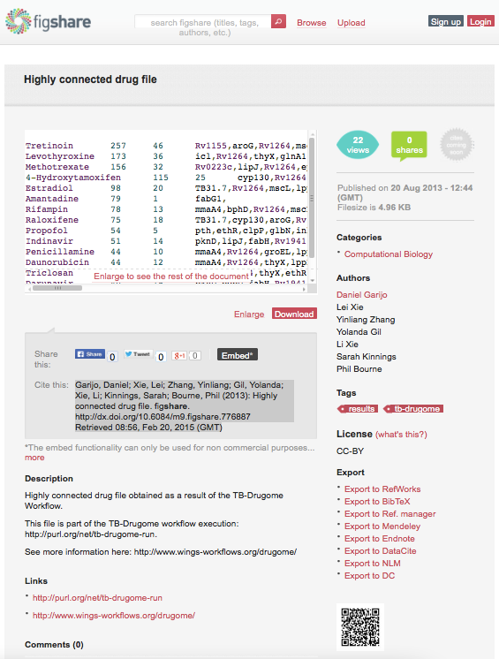
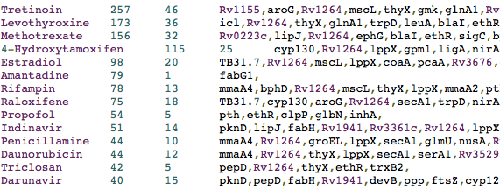
Manual Accessibility
UNIQUE ID & METADATA
http://figshare.com/articles/Highly_connected_drug_file/776887
DATA
http://files.figshare.com/1175525/highlConnectedDrugs.txt

Slide 11

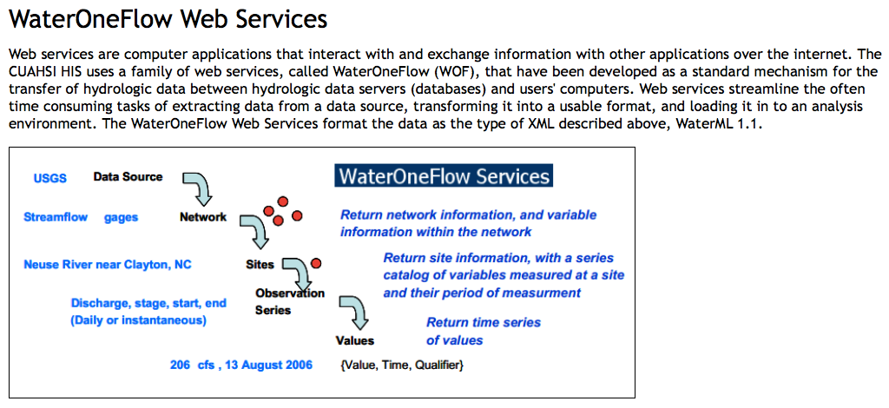
Machine Accessibility: Metadata is a Necessity!
Standard mechanism for the TRANSFER of hydrologic data between hydrologic data servers (databases) and users computers, streamlining the tasks of extracting data from a data source, transforming it into a usable format and loading it in to an analysis environment.
https://www.cuahsi.org/Standards
Notes:
WaterOneFlow, that have been developed as a standard mechanism for the TRANSFER of hydrologic data between hydrologic data servers (databases) and users computers. Web services streamline the often time consuming tasks of extracting data from a data source, transforming it into a usable format and loading it in to an analysis environment.

Slide 12
Making Data Accessible: Overview of Best Practices
Publication in a
shared repository
1
2
General & domain metadata
3
Accessibility of
data (manual & machine)
Unique persistent
identifier (PID)
4
5
Citation preference

Slide 13
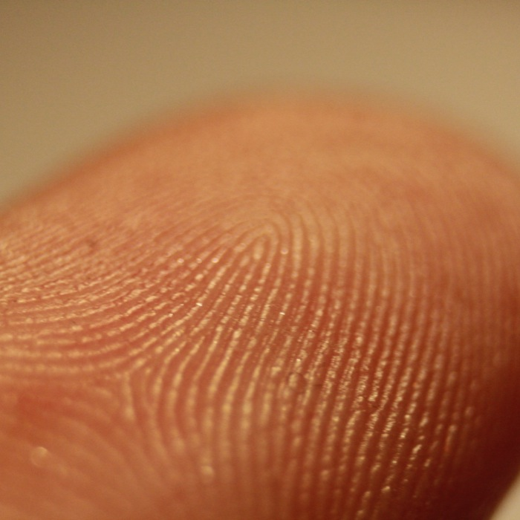
Main Types of Unique Identifiers
Uniform Resource Locator (URL)
Persistent URL (PURL)
Digital Object Identifier
"Fingerprint detail on male finger" by Frettie - Own work. Licensed under CC BY 3.0 via Wikimedia Commons - http://commons.wikimedia.org/wiki/File:Fingerprint_detail_on_male_finger.jpg#mediaviewer/File:Fingerprint_detail_on_male_finger.jpg
Notes:
URL: Uniform Resource Locator

Slide 14

URL/URI: Uniform Resource Locator
Minimal effort to create
No guarantee of persistence
i.e., almost guaranteed it will not have persistence
e.g., http://www.greatuniversity.edu/gradstudents/joesmith/awesomedata/
Do not use in papers!!
"Internet1" by Rock1997 - Own work. Licensed under GFDL via Wikimedia Commons - http://commons.wikimedia.org/wiki/File:Internet1.jpg#mediaviewer/File:Internet1.jpg
Notes:
URI: Uniform Resource Identifier / URL: Uniform Resource Locator (a type of URI)

Slide 15

Persistent URL (PURL)
The same PURL can be resolved to different Web address over time
You always refer to your data with the same PURL: http://purl.org/mydataandme/awesomedata.html
Today you are in grad school and tell purl.org to resolve it to: http://www.wisc.edu/myadvisorsgroup/awesomedata.html
Tomorrow you have graduated and tell purl.org to resolve it to: http://www.stanford.edu/myowngroup/awesomedata.html
It is easy to create your own PURLs, just remember to update whenever you move the data
Go to https://w3id.org (run by W3C), http://www.purl.org (run by OCLC), or other PURL services
"Internet1" by Rock1997 - Own work. Licensed under GFDL via Wikimedia Commons - http://commons.wikimedia.org/wiki/File:Internet1.jpg#mediaviewer/File:Internet1.jpg

Slide 16
Digital Object Identifier (DOI)
DOIs can only be issued by a DOI authority (e.g., a journal publisher)
Data repositories can issue DOIs for data
"Internet1" by Rock1997 - Own work. Licensed under GFDL via Wikimedia Commons - http://commons.wikimedia.org/wiki/File:Internet1.jpg#mediaviewer/File:Internet1.jpg
Notes:
DOIs can only be issued by a DOI authority (eg a journal publisher)
Data repositories can issue DOIs for data

Slide 17
Making Data Accessible: Overview of Best Practices
Publication in a
shared repository
1
2
General & domain metadata
3
Accessibility of
data (manual & machine)
Unique persistent
identifier (PID)
4
5
Citation preference

Slide 18


Data Citation
Data repositories and journals often specify how to cite data
Authors
Date of
publication
Name
Repository
Persistent
unique identifier
Time of
retrieval

Slide 19
Making Data Accessible: Cite the data in your paper
Citation goes in the References section
How to cite the data? You choose:
With an in-text pointer as you would cite any other paper (recommended)
With an in-text pointer in the “Acknowledgments” section
Final
data
Initial
raw data
Intermediate data

